Slide 1

The push for “Open Banking”
ECB-PUBLIC
The European way
4/3/2020
Holger Neuhaus
Head of Division

Slide 2

Disclaimer
ECB-PUBLIC
The views expressed are my own and do not necessarily represent the ones of the European Central Bank

Slide 3
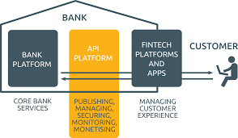
What will be the way to Open Banking?
ECB-PUBLIC
Process led or enforced by legislators or regulators, pushing for stronger competition, innovative services.
Cooperation between banks
and third-party providers,
based on mutual interests.
Making functions and data traditionally
locked and used within a bank for providing
services to its own customers, also
useable for other (‘third-party’) providers.

Slide 4
Eurosystem retail payments strategy
ECB-PUBLIC
Pan-European reach and customer experience
Global acceptance in the longer term
Convenient and cost-efficient
Safe and efficient
European brand and governance
Need for a pan-European solution for payments to merchants
Instant
Payments

Slide 5
Potential role for third-party providers
ECB-PUBLIC
Alternative to cards
Based on pan-European credit transfers
Established presence in e-commerce
Expanding to physical point-of-sale

Slide 6
TPP payment solutions: challenges
ECB-PUBLIC
Becoming truly pan-European
Dependency on banks
Achieving global acceptance
Reach
Branding
Governance
Strong customer authentication
Interfaces
Potential for eID/ eSignatures

Slide 7
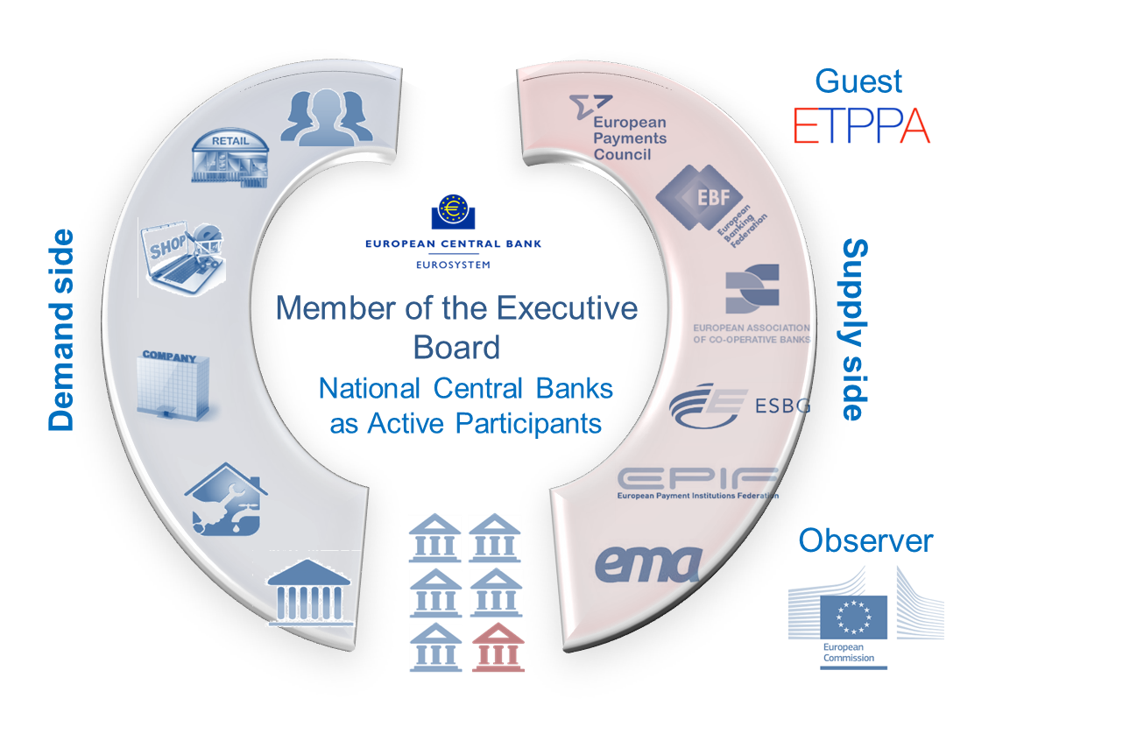

Euro Retail Payments Board (ERPB)
ECB-PUBLIC

Slide 8
ERPB achieved progress towards integrated, innovative and competitive retail payments in euro in the EU in the following fields:
ECB-PUBLIC
Post migration issues related to SEPA Credit Transfer and Direct Debits
Pan-European
e-mandates
Technical standards for card payments
Mobile and card-based contactless proximity payments
Current focus
Instant payments
P2P mobile payments
E-invoice presentment and payment (EIPP)
Instant at point of interaction (POI)
SEPA API access Scheme

Slide 9

ERPB work on Open Banking
ECB-PUBLIC
PSD2 included Payment Initiation Services as a payment service
How to reap the full benefits?
How to leverage the new technical basis (APIs)?
ERPB working group on a SEPA API access scheme defined:
business requirements
governance model
legal aspects

Slide 10
A possible SEPA API access scheme
ECB-PUBLIC
Payments …
enrolment, delegation of authentication, ‘pay-later’, real-time ‘payment guarantee’
… and beyond
access to other accounts, e-Identity
Covers data and transaction initiation services for …
ERPB agreed in June 2019 to consider possibly
resuming the work after PSD2 implementation

Slide 11
Conclusions
ECB-PUBLIC
European payments
Europe needs a pan-European solution for payments to merchants
PSD2 basis
PSD2 is the initial step towards Open Banking in the EU
Open Banking
ERPB explored a SEPA API access scheme for payments, and beyond
Third-party provider solutions could meet the Eurosystem’s objectives
Open Banking will be successful if stakeholders see mutual benefits

